Slide 1
Sprint Retrospective
10/08/2018

Slide 2
Objectives / Agenda
Re-cap on what is a sprint retrospective
Review the week’s sprint
People
Relationships
Process
Tools
Identify what went well, and what could be improved
Decide how improvements can be absorbed into our ways of working for the next sprints

Slide 3
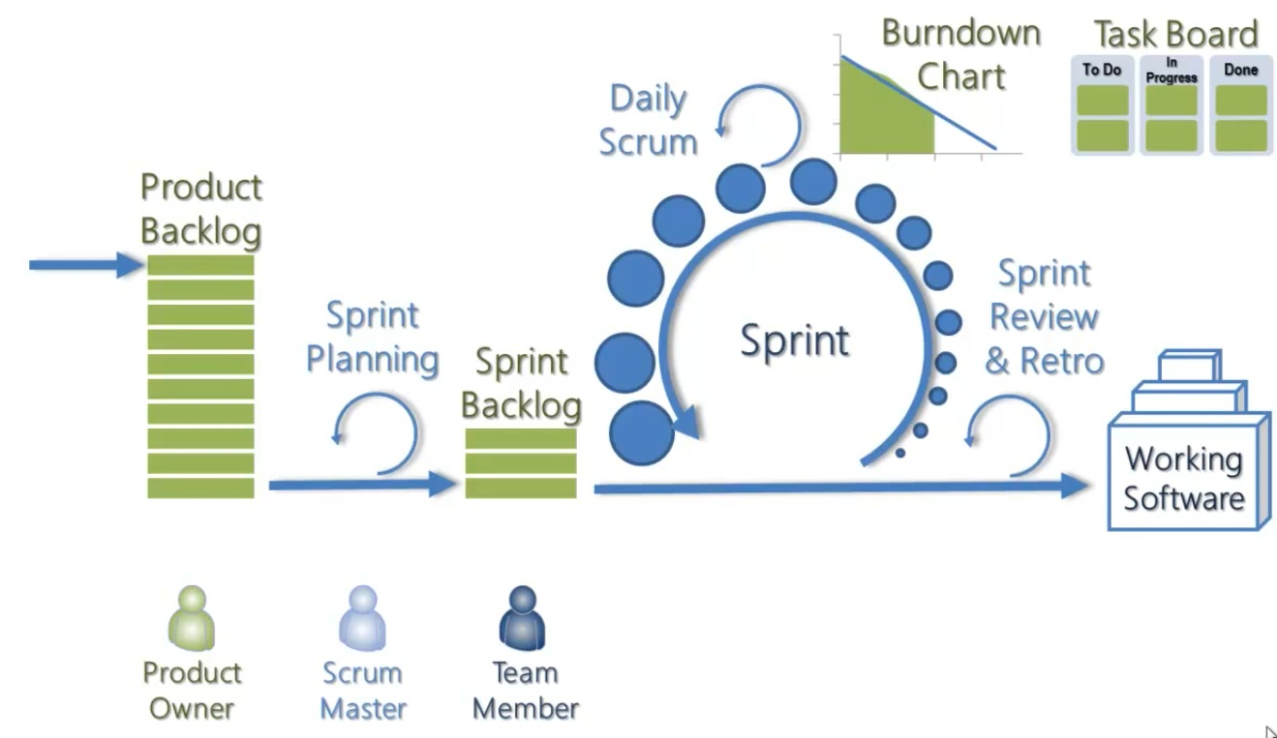
What is Agile and what are SCRUM ceremonies?
Agile is a group of development methodologies based on iterative development
Requirements and solutions evolve through collaboration between self-organizing cross-functional teams.
Encourages teamwork, self-organization and accountability
The Agile Manifesto states that:
Individuals and interactions over processes and tools
Working software over comprehensive documentation
Customer collaboration over contract negotiation
Responding to change over following a plan

Slide 4

Sprint retrospective
The team reviews how they performed
What went well?
What didn’t work so well?
How can we improve?
What actions can we take to make it happen!?
Take a structured approach
Facilitated by the scrum master
Time boxed to approx. An hour
Very open and honest
Can get emotional!
A good retrospective can provide us:
Takeaways on how to improve my personal process and/or role, as well as an opportunity to voice potential team-wide process improvements, have conversations around how to be better as a team, and how to better engage with our clients in the future
Help the team identify areas for improvement and provide a platform to talk about values or results the whole team can work on going forward.
Insight and collaborative feedback into what is going well within the team, what isn’t and what can be improved. The best-case scenario is when the team is guided to create and experiment with solutions to challenges on their own.

Slide 5
Review of this week’s activity
Lot of design sessions – they could be improved in terms of focus to be clear on who should join
Process being discussed through calls and sharing files makes it challenging- maybe live screens / demos of process makes it more productive
Sharing details – demos will be useful
Clarity on requests and timelines – to be followed up and reduce re-work
Share info with UL stakeholders as we go
Share SCRUM and hyperledger material – with UL
Team is very cooperative
Overall design architecture for end to end flow – required for analysis stage
We are more technical question orientated than business focused – business requirements need to come from them
Team speaking up in calls
Need to focus on clarity on the business needs – we validate technical questions from that so let’s document what’s needed first
Estimation we need more clarity beforehand
Some repetition of user stories in the sessions – focus on consolidation
Tight timelines for inputs
Clarity on process
Tools – more use of confluence

Slide 6
What went well? – Continue
Level of interaction is awesome – trying to bridge the gap
Inclusion of all relevant team members is good
Even if requirement isn’t clear, we have made some progress and the Dev team are requesting additional info where required
Generated good number of user stories, a good platform
Good interaction. Understanding clarity on requirements is moving forward
Very cooperative and responsive team
Sessions have been brainstorming so works towards an answer

Slide 7
What can be improved? – Start, Stop
Stop last minute meetings where possible
Start more clarity with actions and times
Demo sessions – start
More flexible during the knowledge info – i.e. understanding exceptions. There may be some exceptions that come up as the team is learning and the scope is wide
Stop – too many queries on specific items – to prevent this start a demo session (indiv easy request, one that requires rework)
Start – merging calls. Time sensitivity
Start – regular governance call (sprint review) involving UL
Start – surfacing exceptions / non happy path
Stop – focusing on high level understanding and focus on granularity to help development
1 day workshop with full FCCR workshop
Start – more business driven questions and focus rather than technical
Sprint planning – start that
Dev team and business team to have a demo
Process deep dive and exceptions – let’s work on that
Stop pushing dev team to start too early before estimations
Granular documentation of user stories – so we can start to get focus for diff dev areas
Attendance at standup - improve

Slide 8
How do we incorporate these improvements?
Demo session to be booked in – show process currently to surface questions
Separate sessions for each process
All team to speak up if the sessions are going into too much detail in the wrong areas
Dan to book sprint review with UL also
Focus on exceptions – more clear documentation, plus demo
FCCR session slightly extended Monday
Business teams to drive towards requirements in sessions, if the discussion is too technical

